Slide 1




FRAUD SHIELD
Big Data Processing Using Data Science Technologies
Team : Wizard No Data
Leader : Nguyen Sy Hai Nam ⭐(Student1388345)
Members : Huynh Do Minh Phuong (Student1388335)
Le Van Khiem (Student1381473)
Pham Duy Khanh (Student1399171)
Le Canh Sang (Student1399117)

Slide 2
CONTENT
Background and Necessity for the Application
Source Data & Idea
Data preparing & Machine Learning
Big Data Technique
Train, Validate, and Test
Analyze Results
Cite Source

Slide 3
Background and Necessity for the Application
The occurrence of cybercrime encompasses a wide range of criminal activities conducted through, within, or against computer applications and networks. As the threats of online fraud and unethical hacking continue to grow, instances of cybercrime are on the rise. To counter these escalating information and cyber safety risks, organizations must be prepared to predict and prevent cybercrime.
Cybercrime experts are leveraging Big Data tools to identify potential threats and detect incidents such as credit card fraud. Big Data Analytics empowers companies to analyze large volumes of data accumulated during financial transactions and other locale-specific information. Combating cybercrime has become crucial in today's landscape due to the serious risk of cyber theft. Big Data tools are employed to defend against cyber-attacks, facilitating the detection of fraud, identification theft, and aiding in digital forensic analysis.

Slide 4
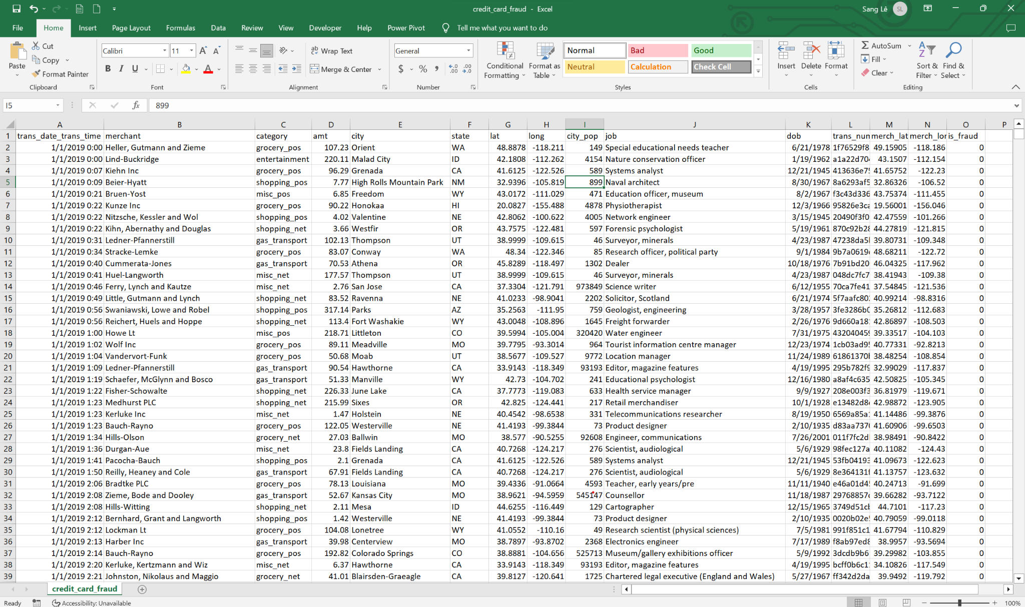
SOURCE DATASET & IDEA
The data we get from: DATACAMP
This dataset consists of credit card transactions in the western United States. It includes information about each transaction including customer details, the merchant and category of purchase, and whether or not the transaction was a fraud

Slide 5
Data Dictionary
Idea
trans_date_trans_time | Transaction DateTime
merchant | Merchant Name
category | Category of Merchant
amt | Amount of Transaction
city | City of Credit Card Holder
state | State of Credit Card Holder
lat | Latitude Location of Purchase
long | Longitude Location of Purchase
city_pop | Credit Card Holder's City Population
job | Job of Credit Card Holder
dob | Date of Birth of Credit Card Holder
trans_num | Transaction Number
merch_lat | Latitude Location of Merchant
merch_long | Longitude Location of Merchant
is_fraud | Whether Transaction is Fraud (1) or Not (0)
From the data we create a credit card fraud detection module
Create a storage system, extract data using Hadoop, HDFS, Spark Apache, Airflow, Cassandra, Pig Latin to find fraudulent objects in transactions
We take the frequency, the timeline, the amount, to build the module to provide a fraud prevention solution.
Help customers protect their accounts the highest, avoid losing as much property as possible

Slide 6
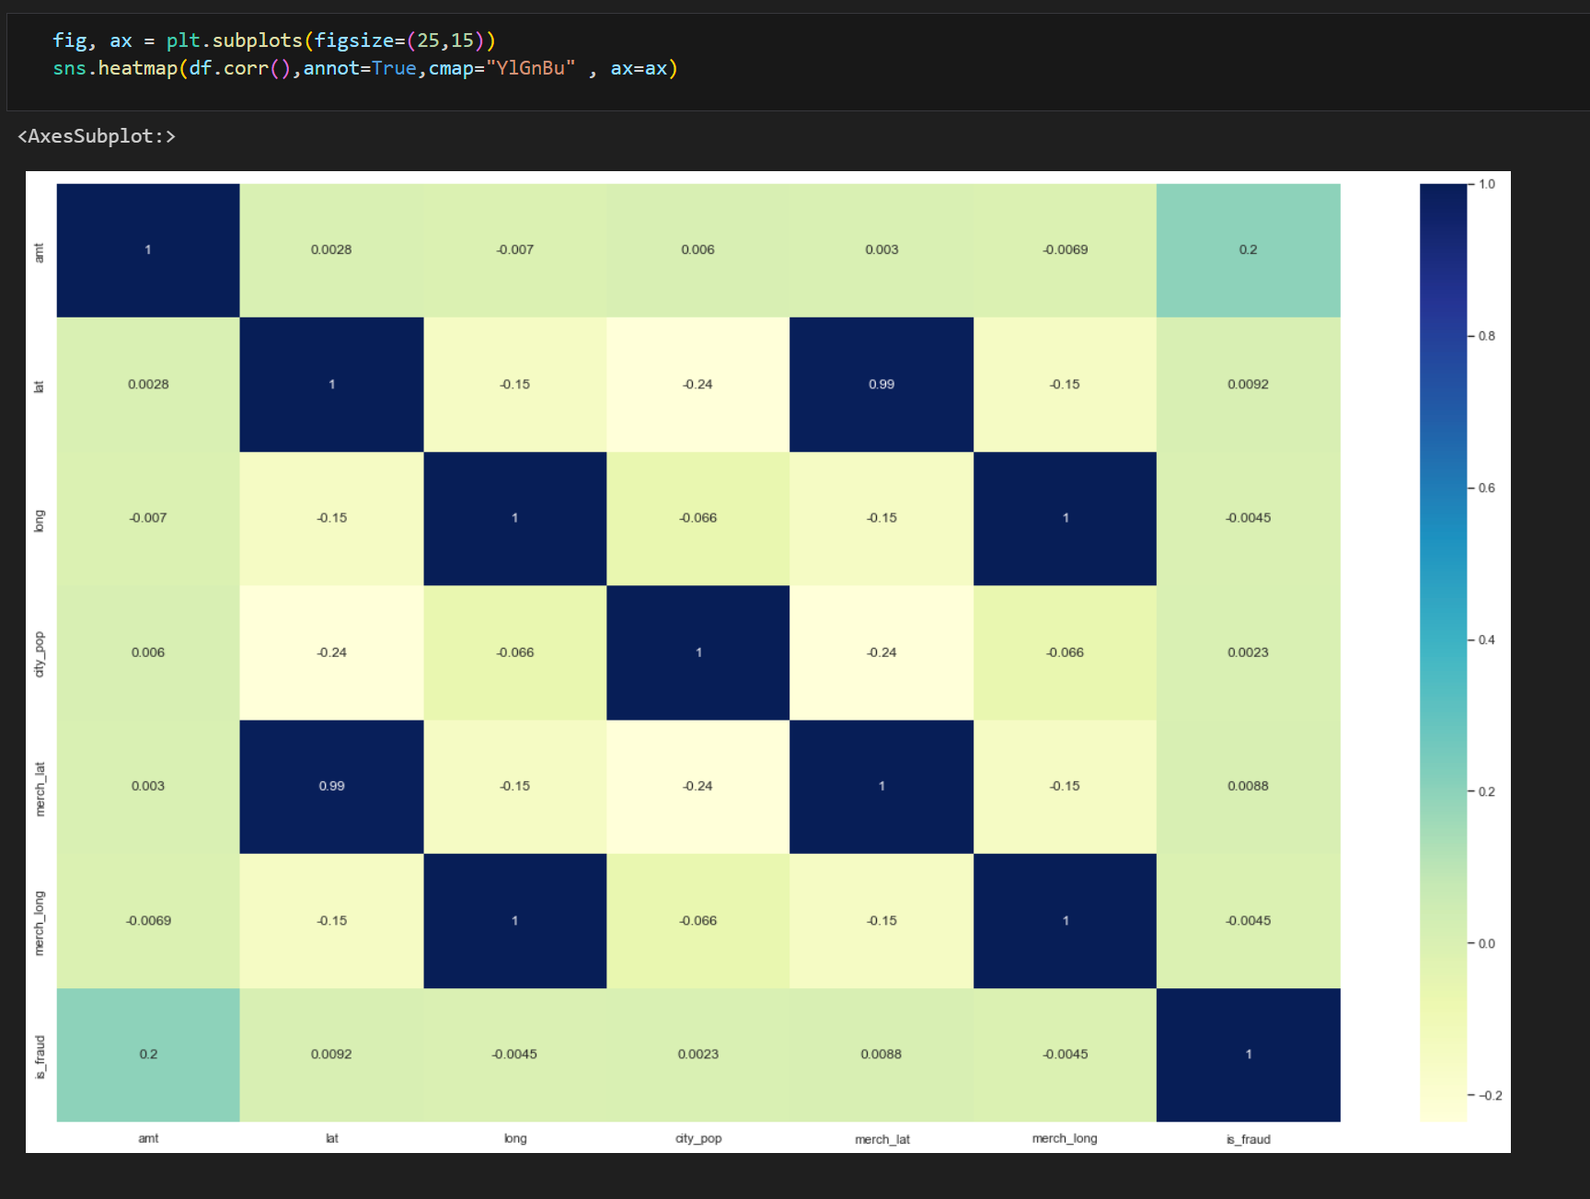
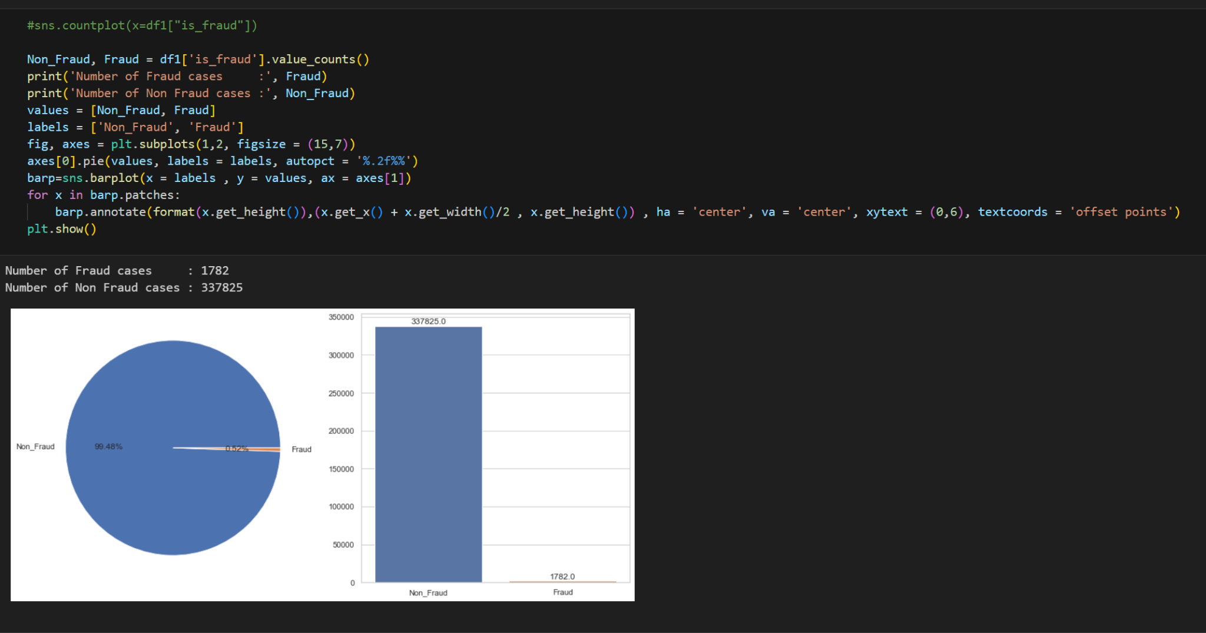
Repair Data & Machine Learning
We analyze three ways: Decision Tree, Random Forest, and Logistics Regression to find the best analytical solution
3. Data cleaning & Machine Learning
Use the corr function to see the correlation of the data, more dark colors are more high correct the more

Slide 7
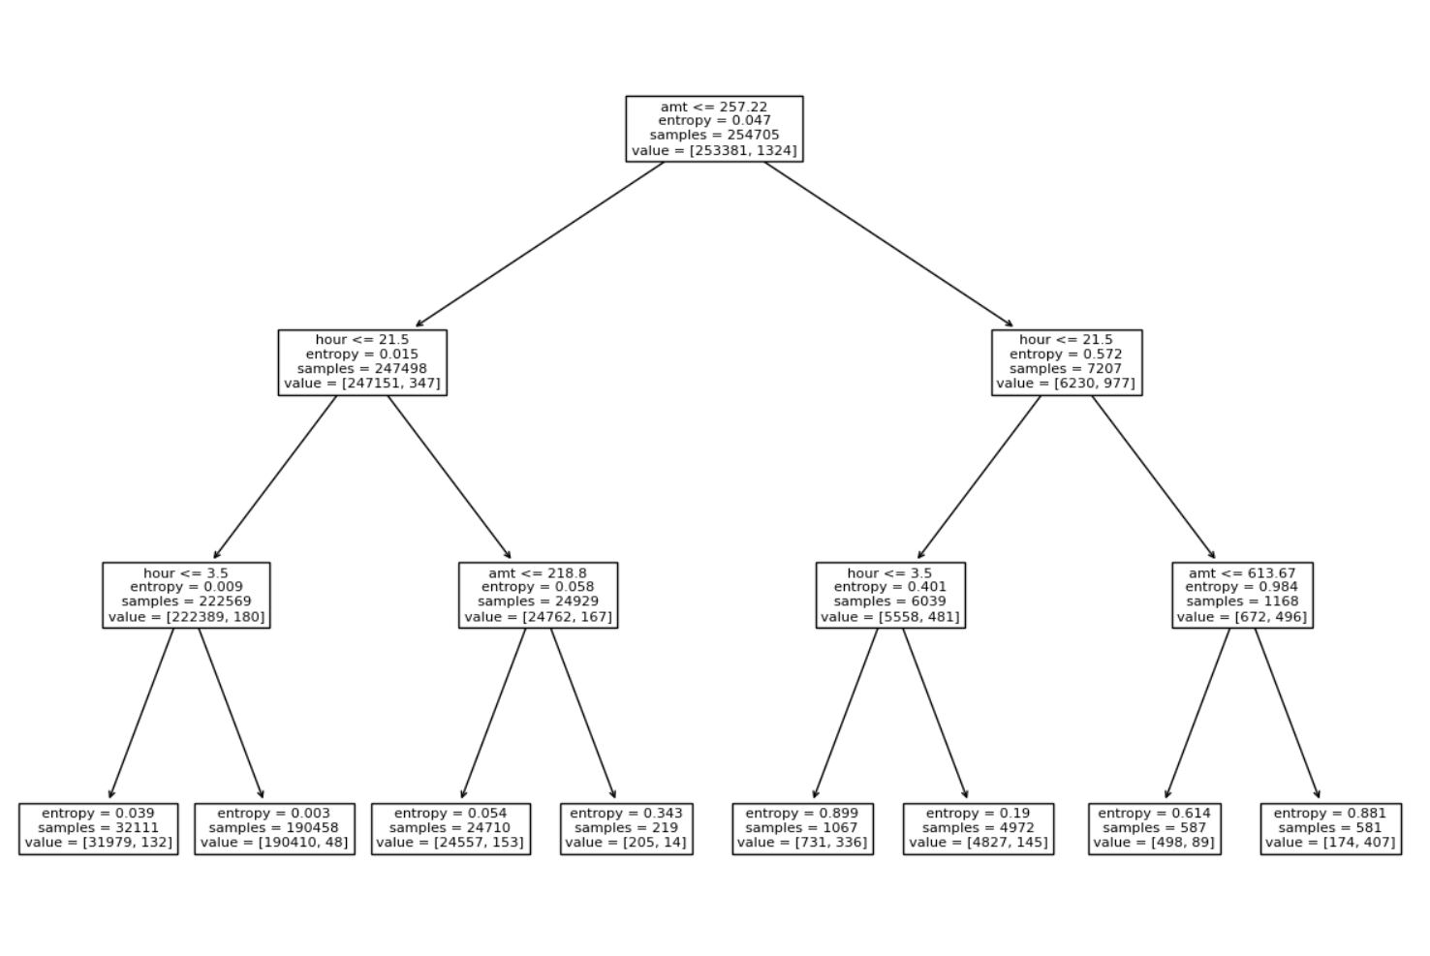
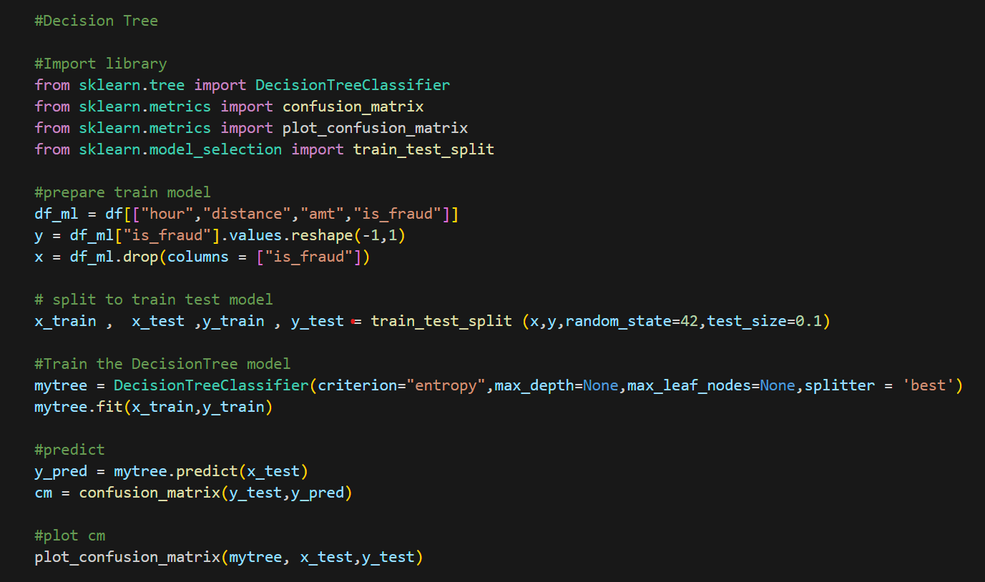
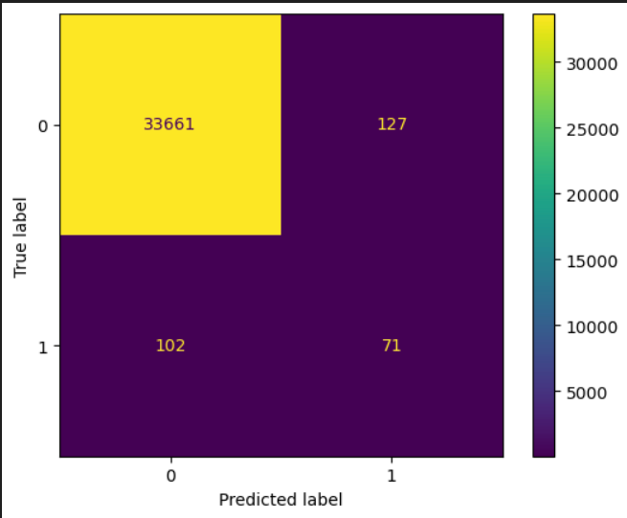
Decision Tree

Slide 8
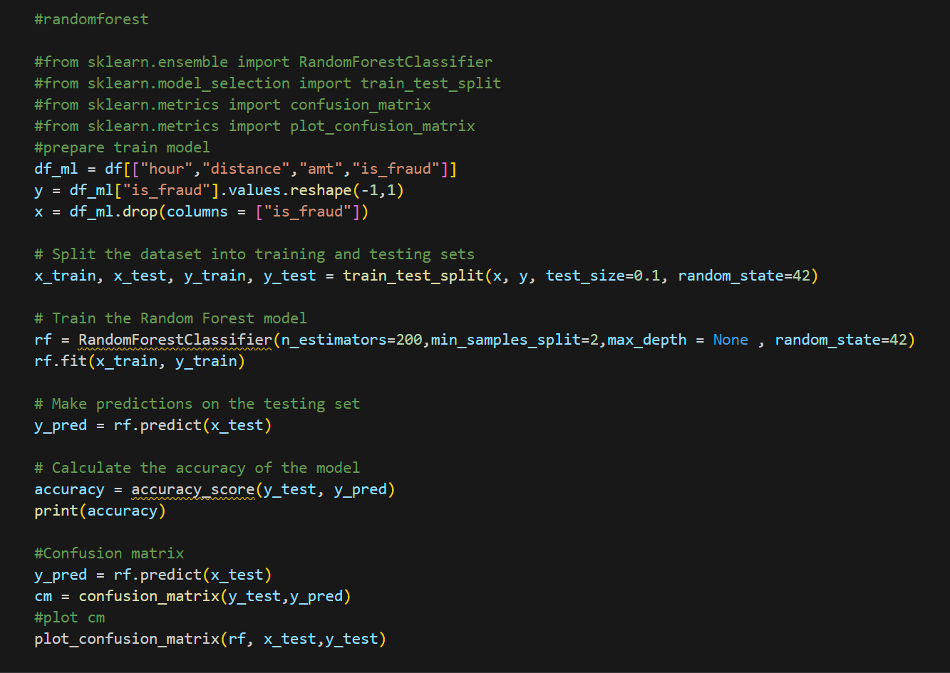
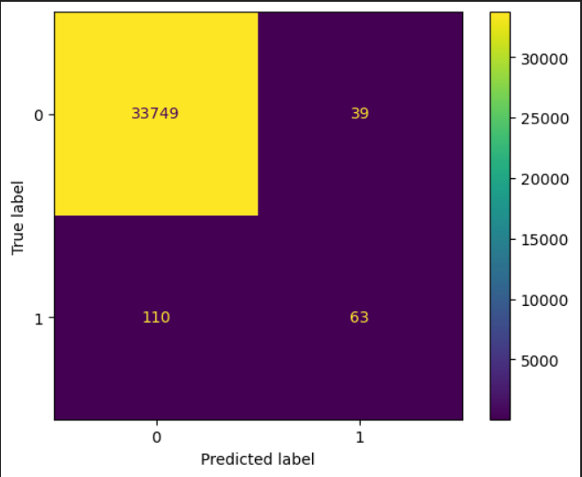
2. Random Forest

Slide 9
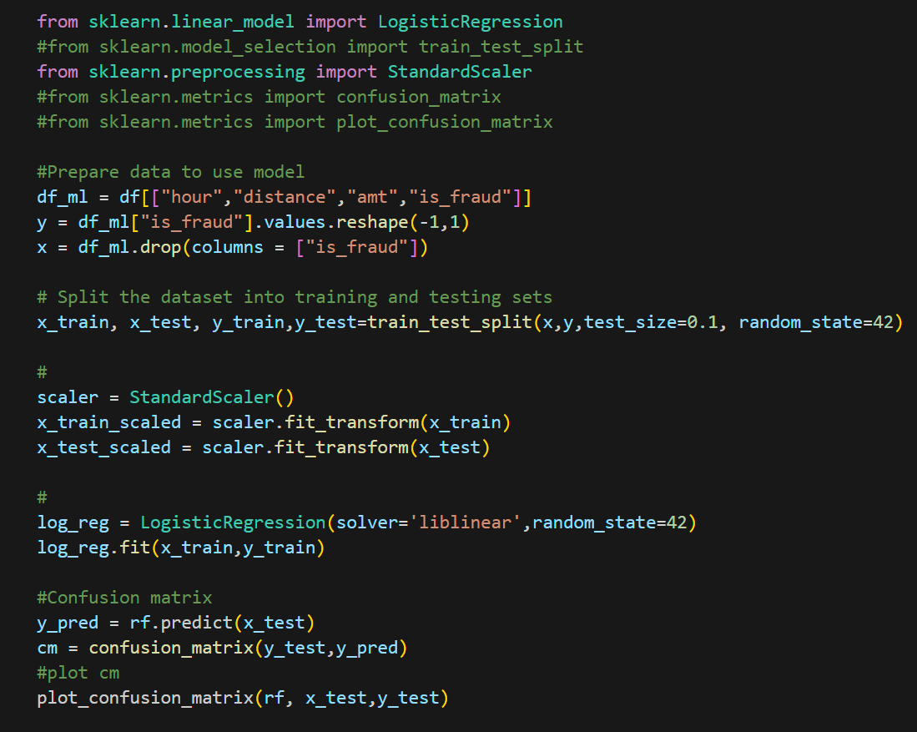
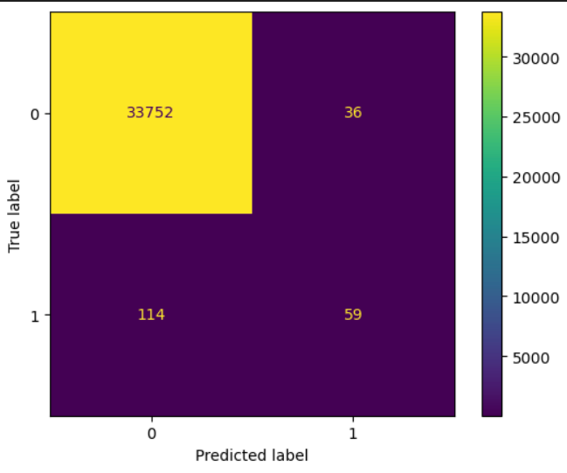
3. Logistics Regression

Slide 10
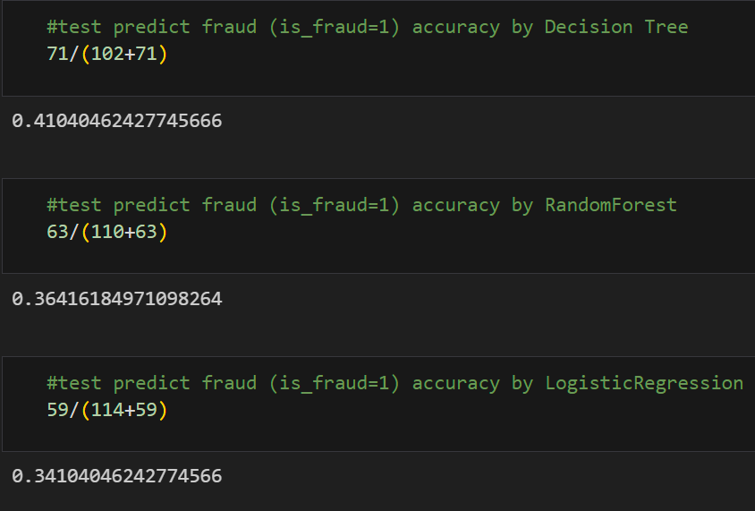
Conclusion
Choose Decision Tree have most accuracy detect Fraud (41.04%).
But RandomForest is good too with (36,41%) detect accuracy.
When We have new transaction use mytree.predict or rf.predict to choose model (Decision Tree or Random Forest) for prediction Fraud, when result = 1 (predict is_Fraud can be 1 with accuracy (69,94%)), we can get email and phone_number of same customer_ID to mail and send SMS the OTP (One Time Password) to confirm that Transaction.

Slide 11
Big Data Technologies
Hadoop 3.3.6
Spark 3.4.1
Other components
OS: Ubuntu 22.04.2-desktop-amd64
Python 3.10
Oracle VirutalBox 7.0
OVA of VM with other components included on github (user: wnd, pass: tech)

Slide 12
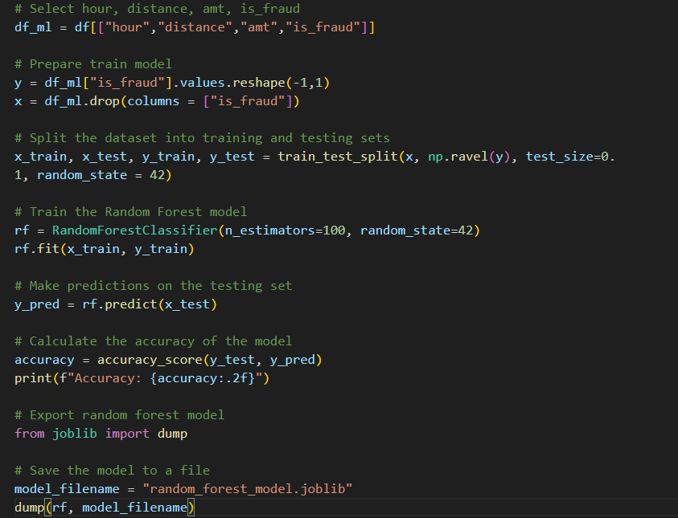
Big Data Technologies
In this project, we will deploy a random forest model on Hadoop
1. Preparing data and export random_forest_model.joblib using joblib library

Slide 13
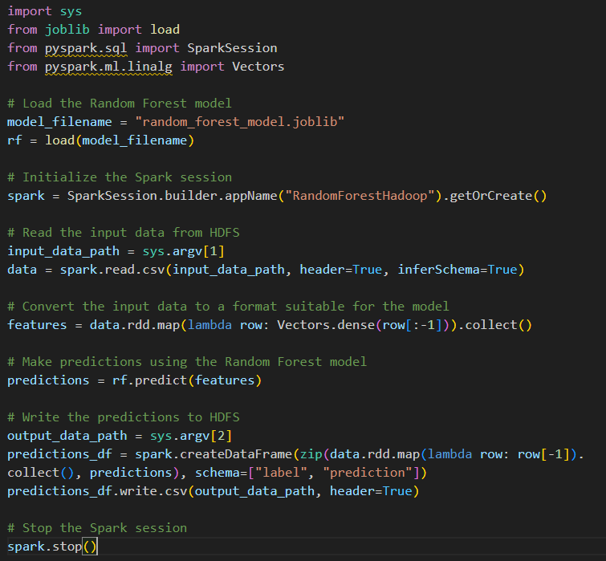
Big Data Technologies
In this project, we will deploy a random forest model on Hadoop
2. Make a python file (random_forest_model.py) to Deploy the prepared model a input data on HDFS

Slide 14

Big Data Technologies
In this project, we will deploy a random forest model on Hadoop
3. Load all prepared file to HDSF
4. Execute Spark-submit with proper params to deploy

Slide 15
Analyze Results
1. The time frame of most fraud transactions happened is between 10PM and 3AM, peaking at 10PM-11PM.
2. The most fraudulent categories are shopping_net, misc_net, shopping_pos and grocery_pos respectively.
3. California is the most fraud state with fraud losses of $205.94K .
4. The age group from 50 to 69 is the most fraudulent age.
5. Engineer job is fraud losses than other careers.

Slide 16
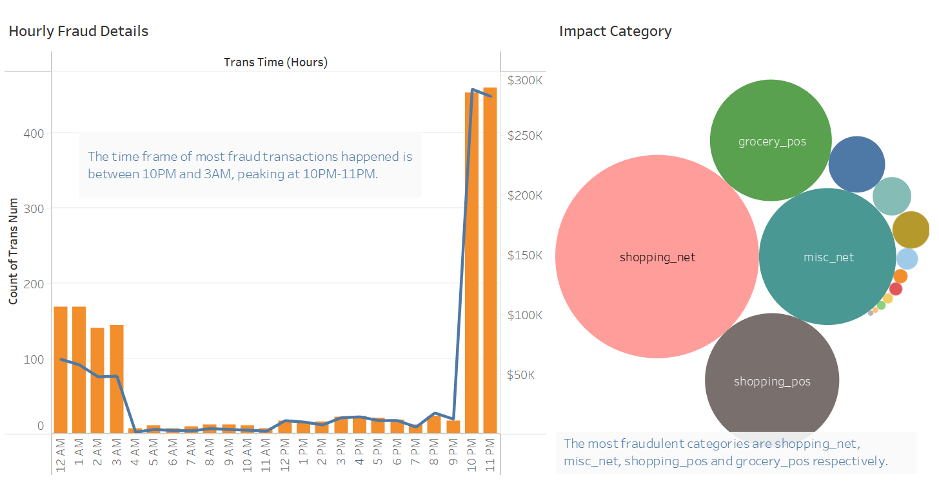

Slide 17
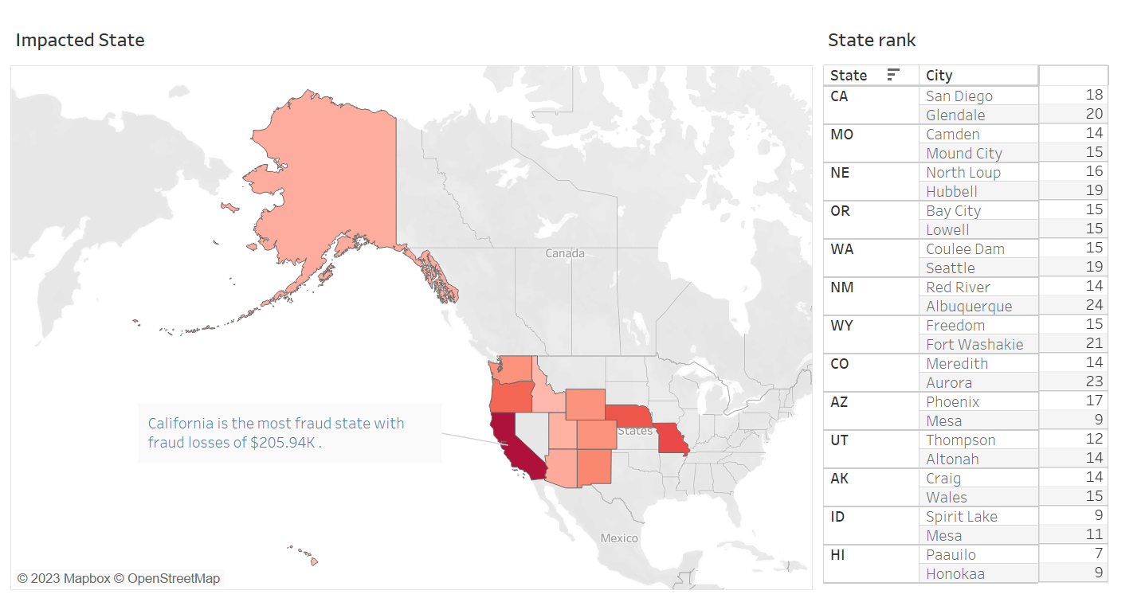

Slide 18
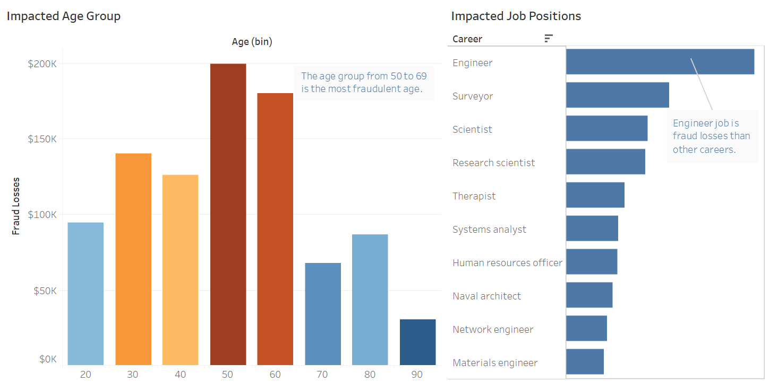

Slide 19
Cite Source
THANK YOU SO MUCH TO EVERYONE HELPED US TO HAVE FINISHED THIS PROJECT
Mentor: Ho Nhut Minh
Source Dataset: https://app.datacamp.com/
Guide Channel: https://www.youtube.com/@miaivn
References: https://fraud-detection-handbook.github.io/
https://seon.io/resources/credit-card-fraud-detection/
https://scikit-learn.org/stable/supervised_learning.html#supervised-learning
https://saturncloud.io/
https://hadoop.apache.org/docs/

